Slide 1



Implementing NDC & SDG-7 in Asia: Low Carbon Technology Development Pathways
Track-1 : Session 1.3
ADB TA: 9690
Anindya Bhattacharya PhD
June 2020

Slide 2

Outline
Status of SDG-7 & NDC target achievement
Scope of the study
Regional baseline of energy and technology mix
National baselines
Initial assessments of progress on NDC and SDG-7 in the region
Focusing on balanced approach of target achievement / Post pandemic readjustment
Way forward

Slide 3
Status of SDG-7 & NDC target achievement
1

Slide 4
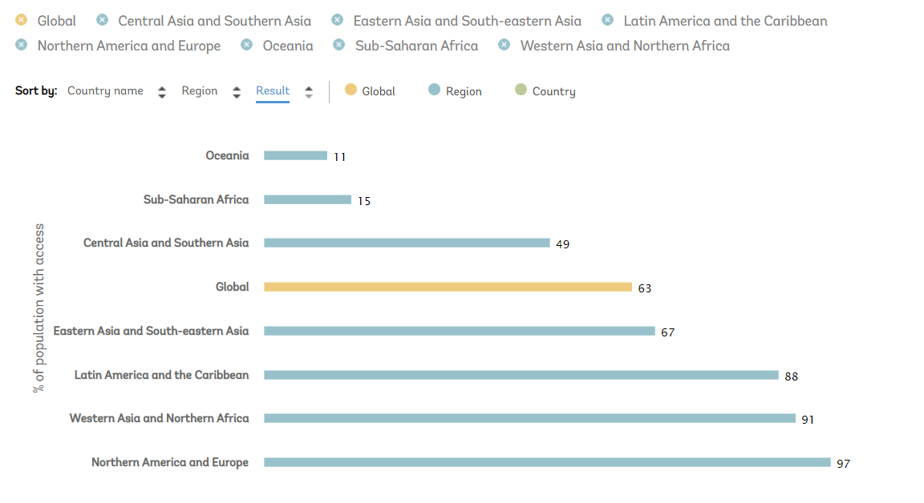
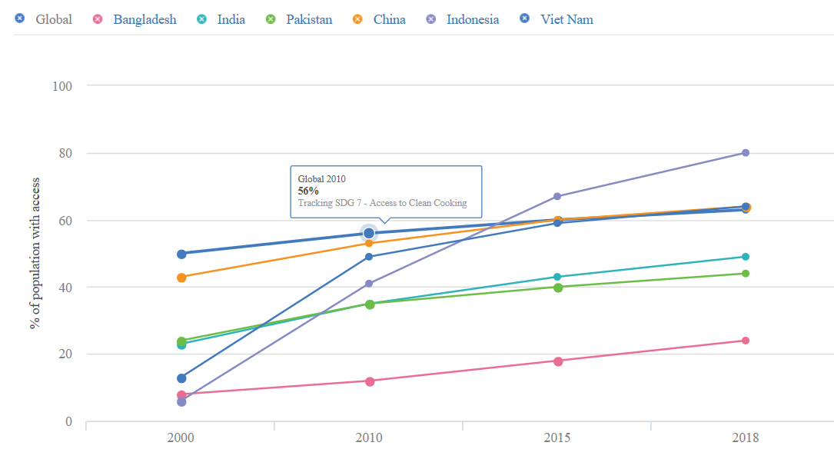
Status of SDG-7 target achievement
Access to clean cooking
03
Source: Climate Action Tracker, ESMAP, 2018

Slide 5
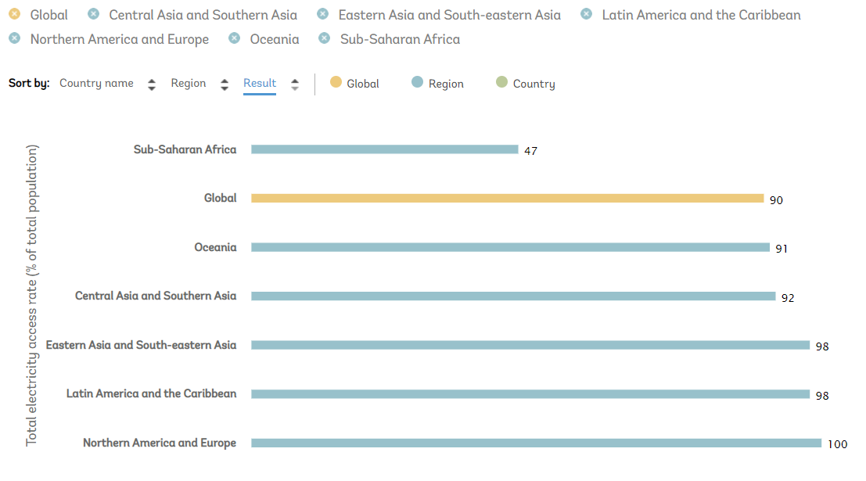
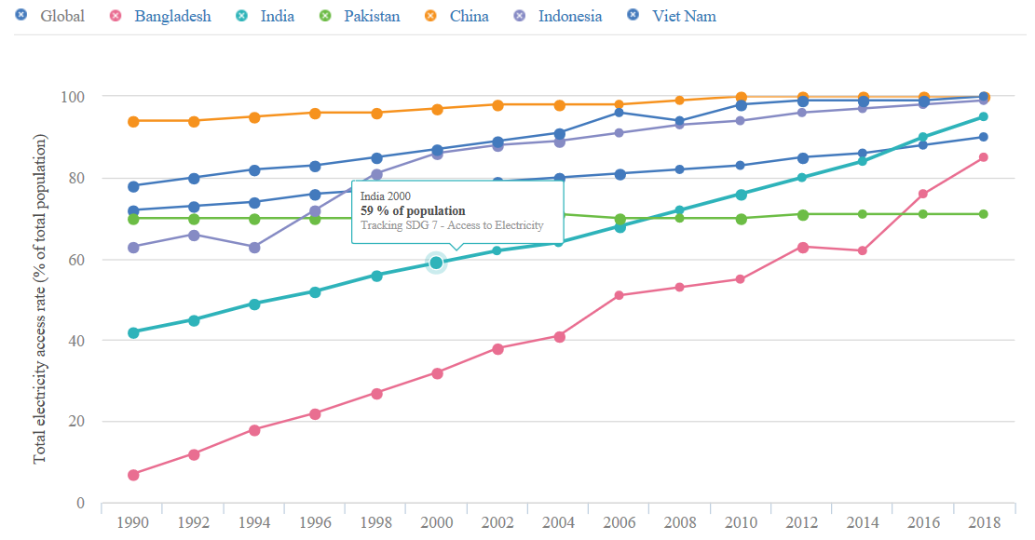
Status of SDG-7 target achievement
Access to electricity
03
Source: Climate Action Tracker, ESMAP, 2018

Slide 6
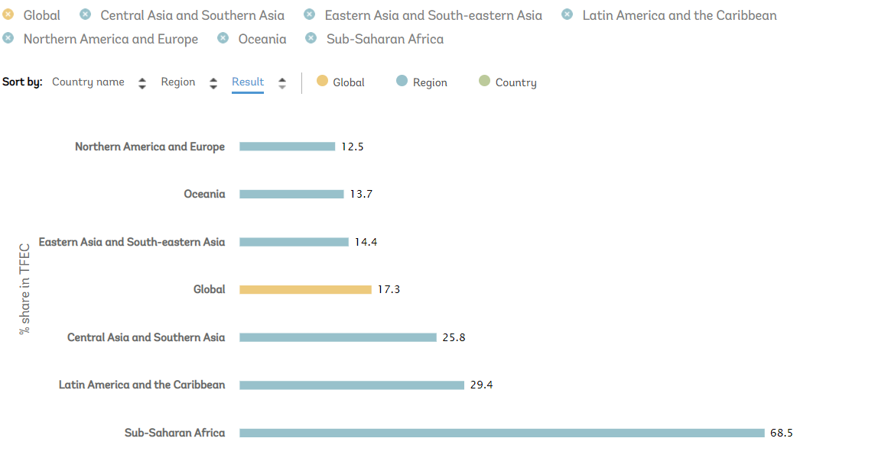
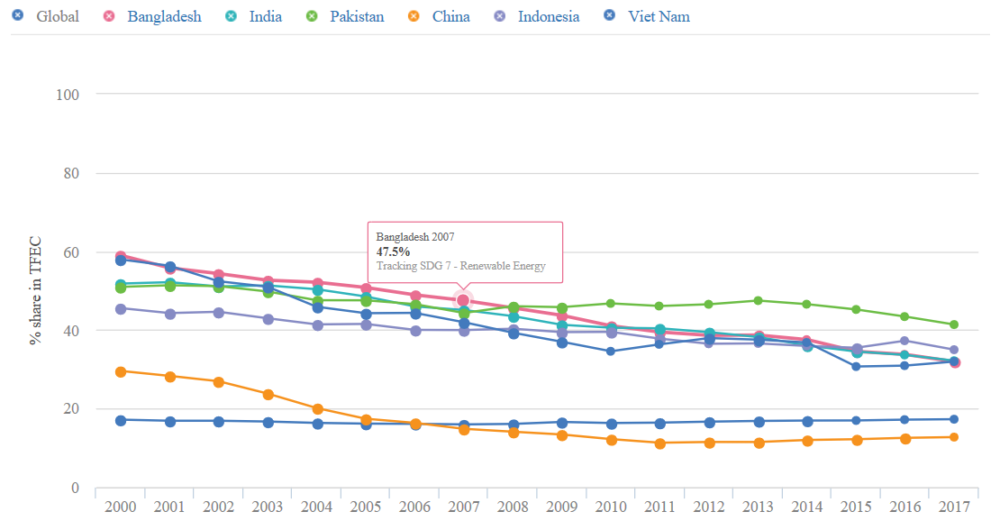
Status of SDG-7 target achievement
Renewable energy penetration
03
Source: Climate Action Tracker, ESMAP, 2018

Slide 7
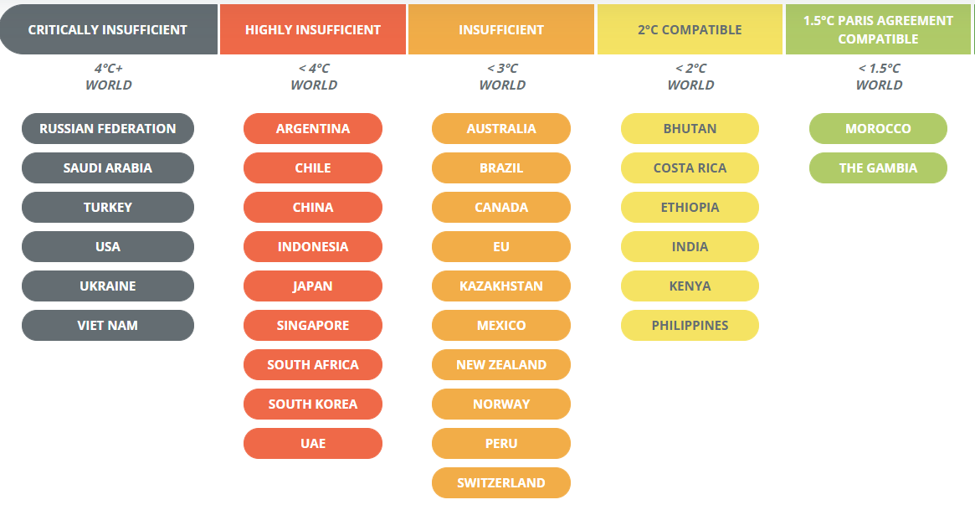
Status of NDC Target Achievement
Global status of NDC targets
03
Source: Climate Action Tracker, ESMAP, 2018

Slide 8
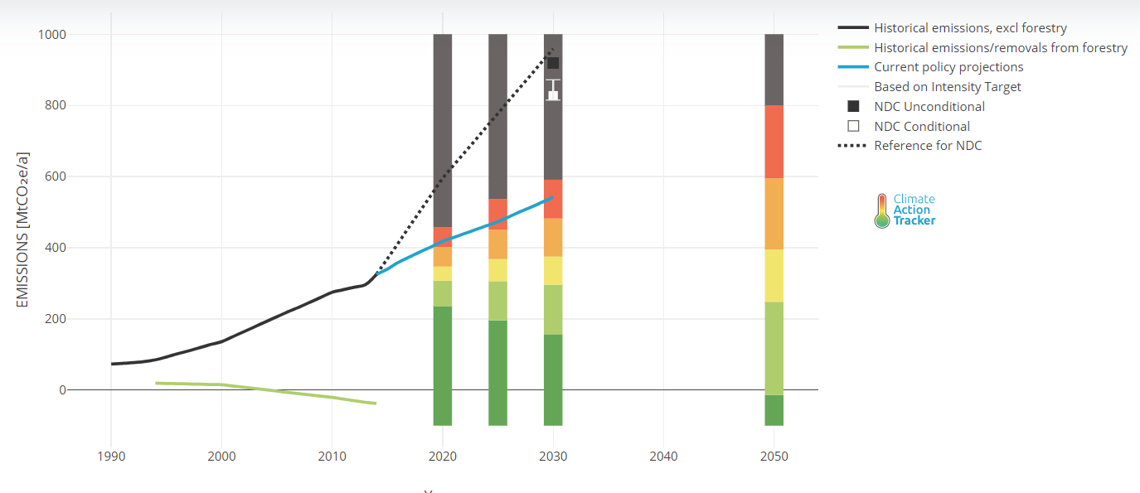
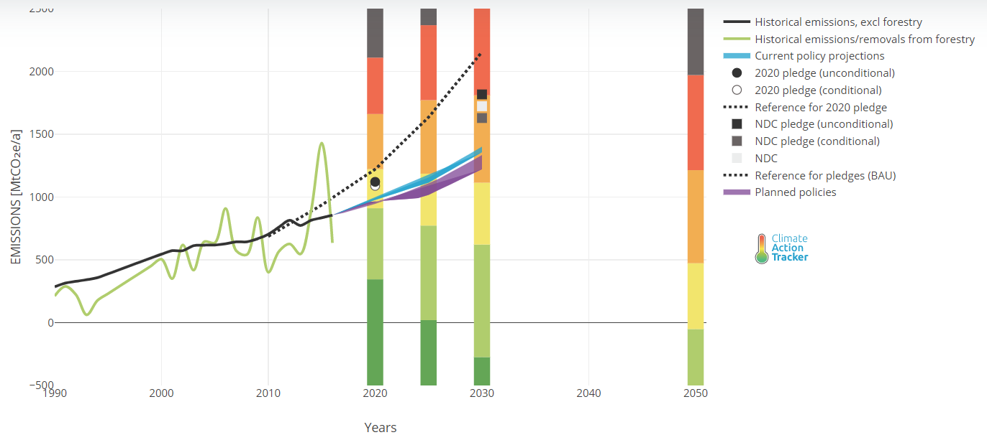
Status of NDC Targets in Case Study Countries
Viet Nam
Indonesia
03
Source: Climate Action Tracker, ESMAP, 2018

Slide 9
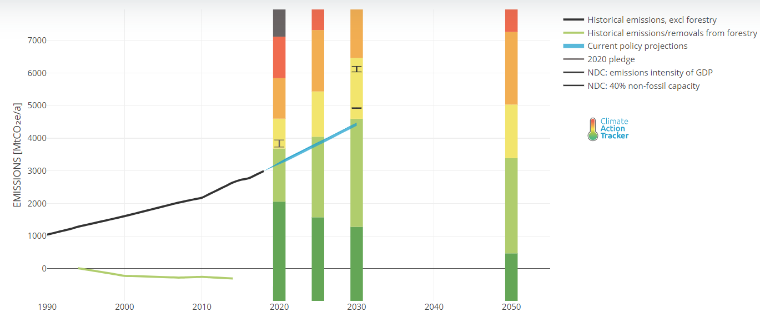
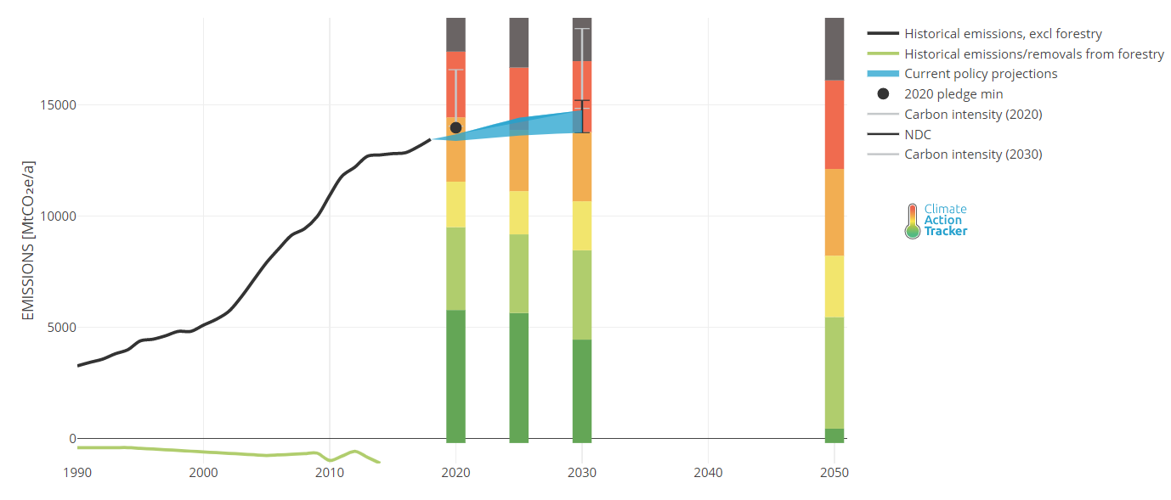
Status of NDC Targets in Case Study Countries
India
China
03
Source: Climate Action Tracker, ESMAP, 2018

Slide 10
Steps to be taken to accelerate activities
Advancing SDG-7 Implementation
- Top priority for clean cooking
- Enhanced electricity access
- Accelerated RE penetration
- Doubling the SDG-7 financing
- Investment in data collection system and data analysis
Strengthening interlinkages between SDG7 & other SDGs
- Harness the cross sectoral interlinkages
- Gender equality and women empowerment
- Promoting low carbon cities
Addressing regional priorities
- Strengthening regional cooperation
- Ending energy poverty
Transition towards sustainable inclusive and equitable energy future
- Promoting transformational investment through inclusive energy system and decentralized RE integration
- Life style change for sustainable living
- Strengthening decision making process by improving energy data collection, analysis and monitoring
03

Slide 11
Scope of the TA
2

Slide 12

Goals and objectives
GOALS
Developing implementable action plans for NDCs and SDG7 in the region including technology roadmap and finance
Develop the Energy Mix outlook and technology pathways for the selected sub regions
Disseminate the knowledge through workshops/
seminars and knowledge products
Develop low carbon energy technology road map for the selected countries
03
Develop low-carbon energy pilot projects for the selected cities

Slide 13
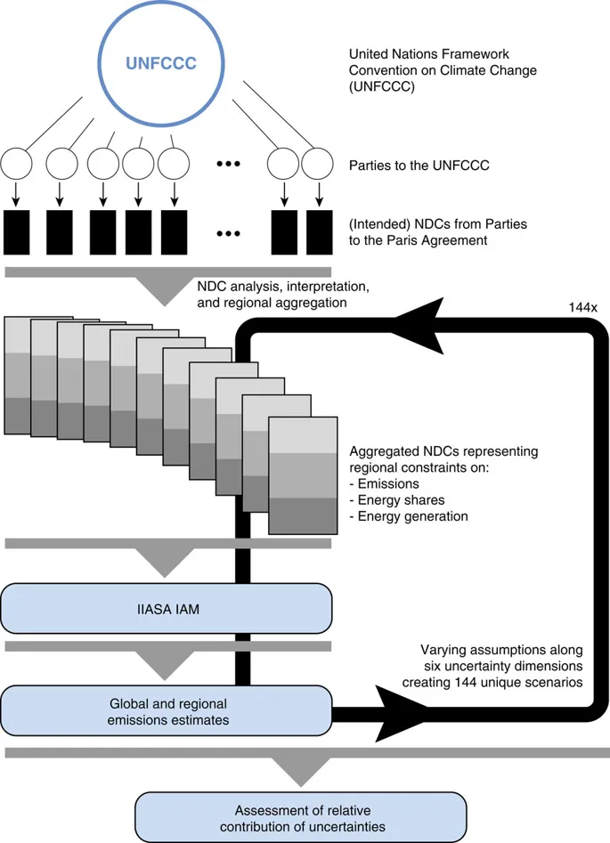
Methodology for integrating NDC and SDG-7 policies
SDG7 Target | SDG7 Indicator | Model Implementation
7.1 By 2030, ensure universal access to affordable, reliable and modern energy services | 7.1.1 Proportion of population with access to electricity 7.1.2 Proportion of population with primary reliance on clean fuels and technology | Electricity demand projections incorporating universal access assumptions Transition to clean technologies for cooking, transportation and buildings Subsidies for transitions to modern fuels.
7.2 By 2030, increase substantially the share of renewable energy in the global energy mix | 7.2.1 Renewable energy share in the total final energy consumption | Constraint on renewable energy share in each region Combined with long-term emission constraints aligned with the Paris Agreement to reflect the important role of clean energy in achieving climate targets.
7.3 By 2030, double the global rate of improvement in energy efficiency | 7.3.1 Energy intensity measured in terms of primary energy and GDP | Increased investment into demand-side measures Global convergence towards energy efficient lifestyles
Sub-region energy mix and investment pathways

Slide 14
Regional baseline assessment
3

Slide 15
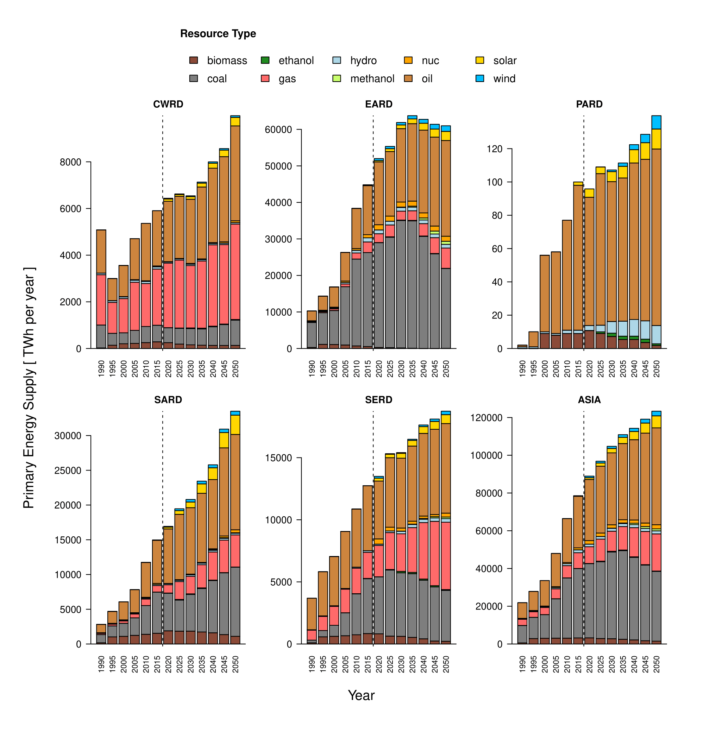

Regional baseline assessment of energy supply and technology mix
Primary energy
Fossil fuels ( coal, oil and gas) are the predominant fuels until foreseeable future in the regions.
Coal as a resource is expected to lose its importance in the mix.
Oil is the single largest energy source of many regions in Asia
Renewable is far behind the expected level of use in the region.
Except Central and South East Asia growth of gas use is limited in the other regions
East Asia region is expected to get its energy peak by 2040
Please Do Not Quote
Source: TA 9690 baseline results ( Results are indicative and subject to change )

Slide 16
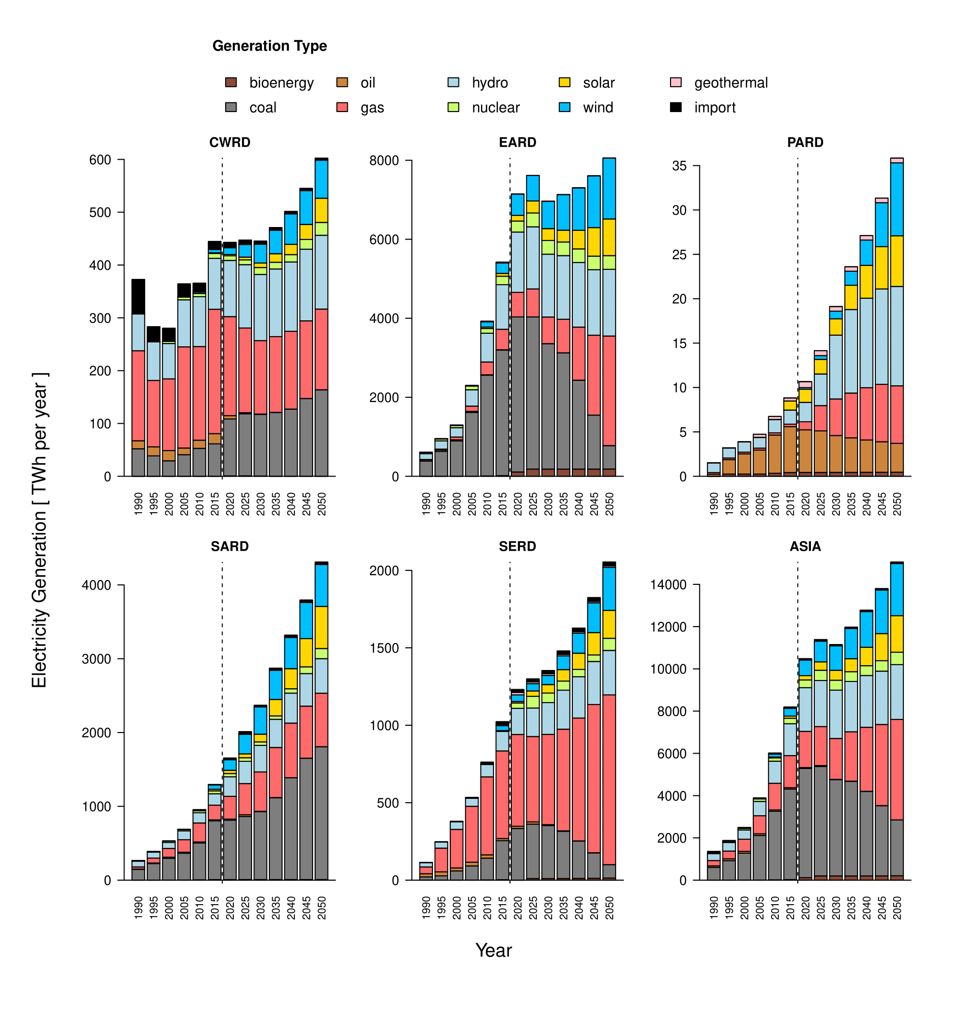
Regional baseline assessment of energy supply and technology mix
Electricity generation
Fossil fuels ( coal and gas) are the predominant fuels for power generation until foreseeable future in the regions
Coal based electricity is expected to lose its importance in the mix
Gas based generation is expected to be significant in many regions especially in South East Asia region
Renewable is far behind the expected level of share mix in the region. However, excluding hydro RE share is even dismal in many regions.
Wind energy is expected to have a larger share in the generation mix compared to solar
On average renewable energy share is expected to be around 20% until 2050
Please Do Not Quote
Source: TA 9690 baseline results ( Results are indicative and subject to change )

Slide 17
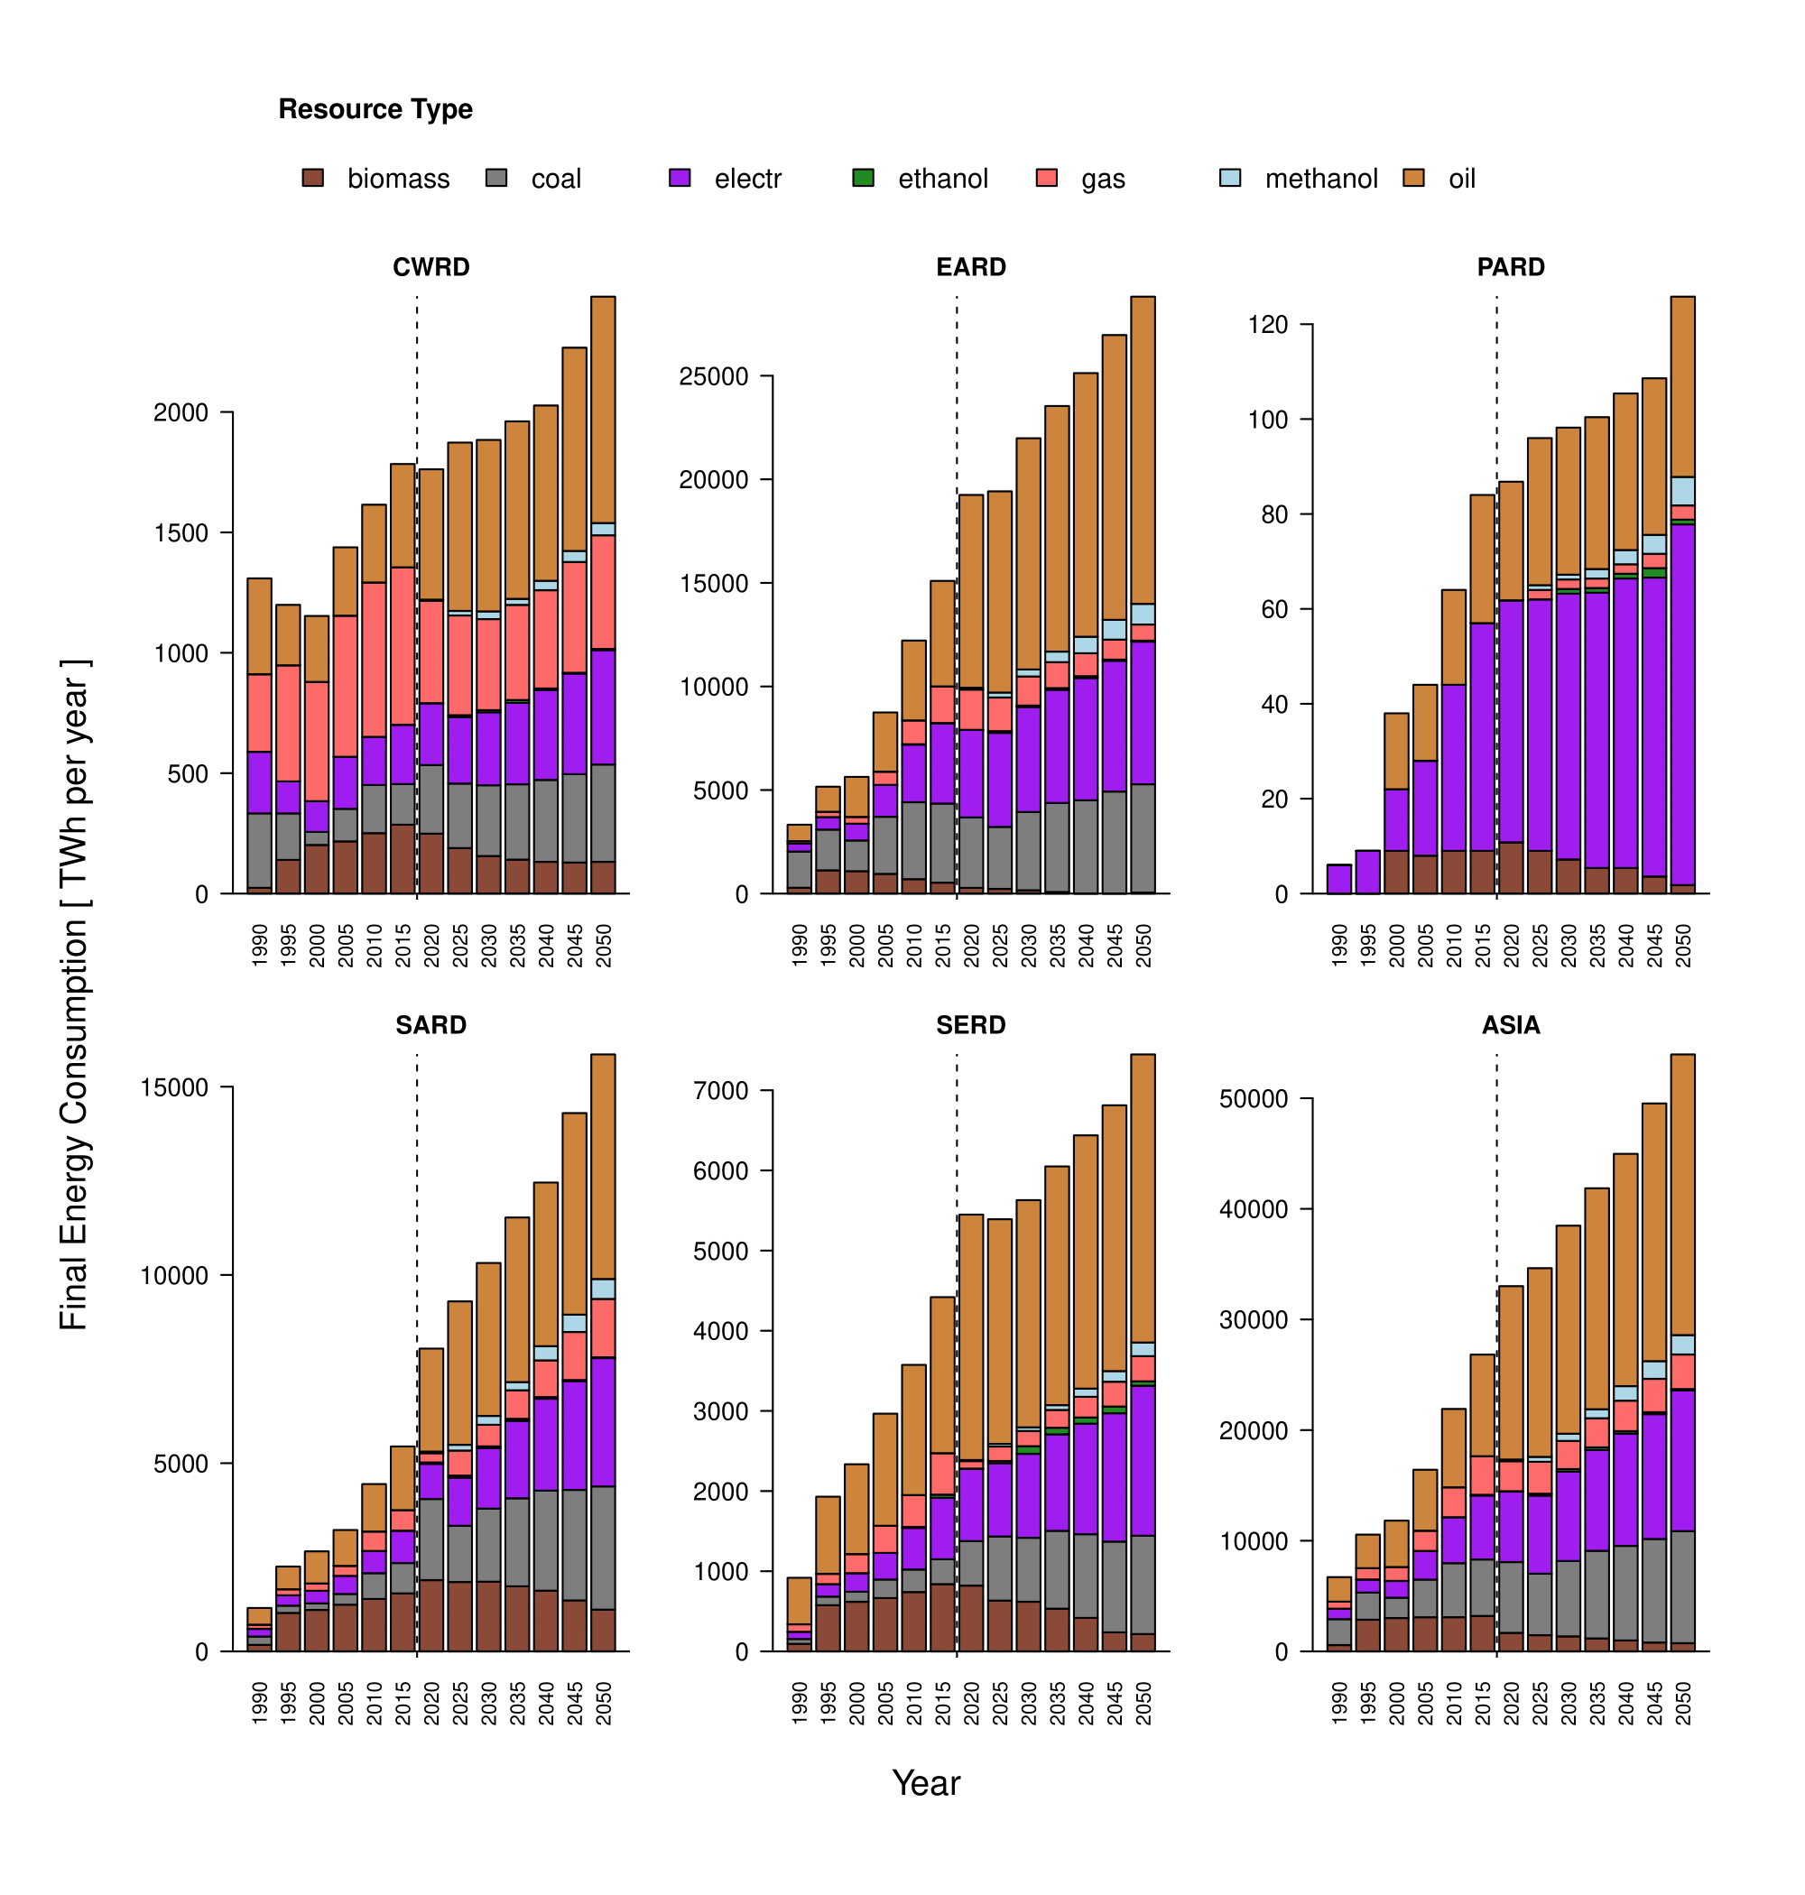
Regional baseline assessment of energy supply and technology mix
Final energy consumption
Oil remains the major source of final energy in the region which is mostly consumed by the transport sector
Pacific region has the highest share of electricity consumption compared to all other regions
Electricity share in overall final energy consumption is well below 20% in all major regions
Access to electricity in the region might be limited
Growth of transport sector and its corresponding consumption of energy has out performed all other sectoral growth and energy consumption
Please Do Not Quote
Source: TA 9690 baseline results ( Results are indicative and subject to change )

Slide 18
National baseline assessment
4

Slide 19
National baseline assessment of energy supply and technology mix
Primary energy (MTOE)
Please Do Not Quote
Source: TA 9690 baseline results ( Results are indicative and subject to change )

Slide 20
National baseline assessment of energy supply and technology mix
Electricity generation mix (TWh)
Please Do Not Quote
Source: TA 9690 baseline results ( Results are indicative and subject to change )

Slide 21
National baseline assessment of energy supply and technology mix
Electricity generation mix (%)
Please Do Not Quote
Source: TA 9690 baseline results ( Results are indicative and subject to change )

Slide 22
Initial assessments of progress on NDC and SDG-7 in the region
5

Slide 23
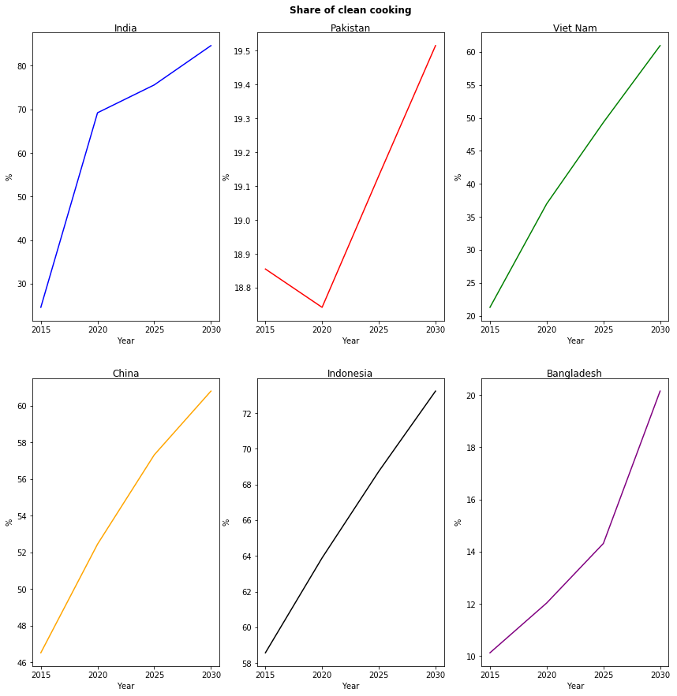
NDC & SDG-7 Performance Indicators @ baseline (Clean cooking)
Clean Cooking share ( use of LPG, PNG, Elec. etc.) is increasing in all the countries in the region
Percentage share of clean cooking widely varies among countries
Share of clean cooking in Bangladesh and Pakistan are the lowest
Please Do Not Quote
Source: TA 9690 baseline results ( Results are indicative and subject to change )

Slide 24
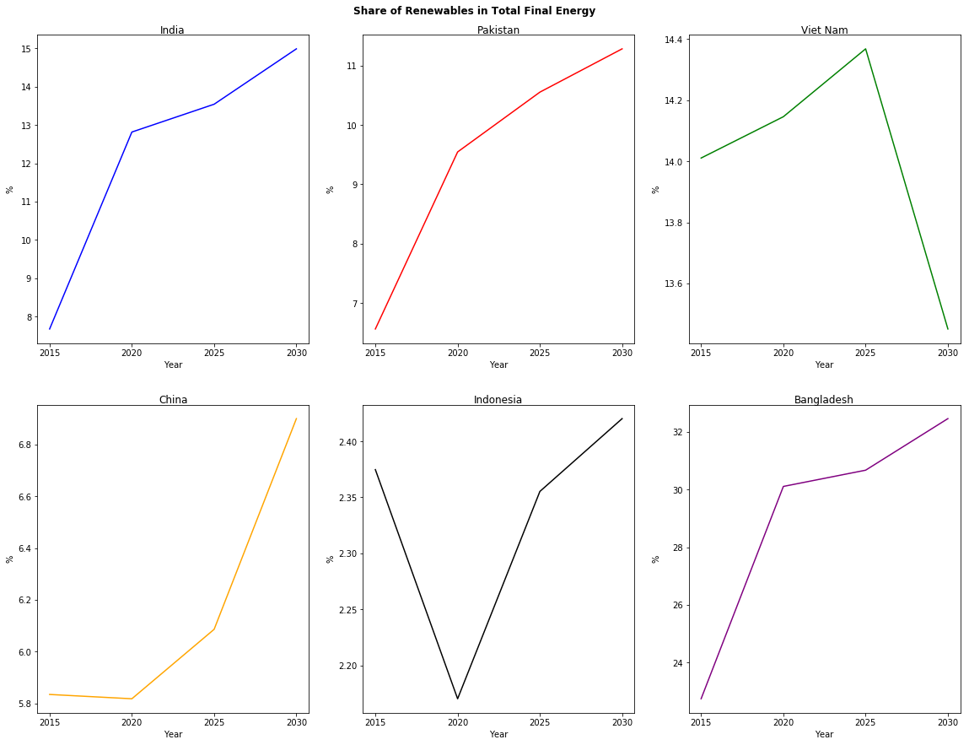
NDC & SDG-7 Performance Indicators @ baseline (RE Share)
Renewable energy (solar, wind, biomass, geothermal, small hydro etc.) share to FEC is increasing for almost all countries in the region
Certain decrease in share indicates slower growth of RE compared to increasing energy consumption
Please Do Not Quote
Source: TA 9690 baseline results ( Results are indicative and subject to change )

Slide 25
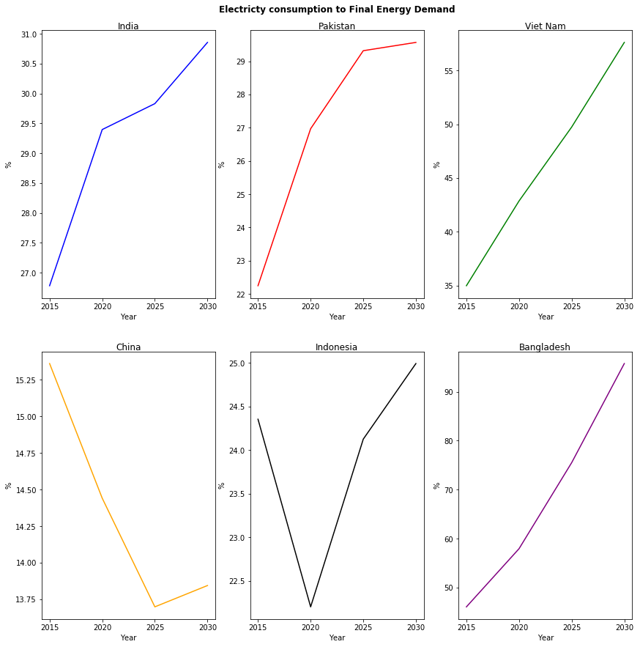
NDC & SDG-7 Performance Indicators @ baseline (Electricity Share)
Share of electricity in FEC is increasing rapidly in most of the countries
Increasing share of electricity indicates cleaner consumption of energy and less emissions
High electricity share in FEC in Bangladesh indicates less industrial activities which requires thermal energy (mostly heavy industries)
Please Do Not Quote
Source: TA 9690 baseline results ( Results are indicative and subject to change )

Slide 26
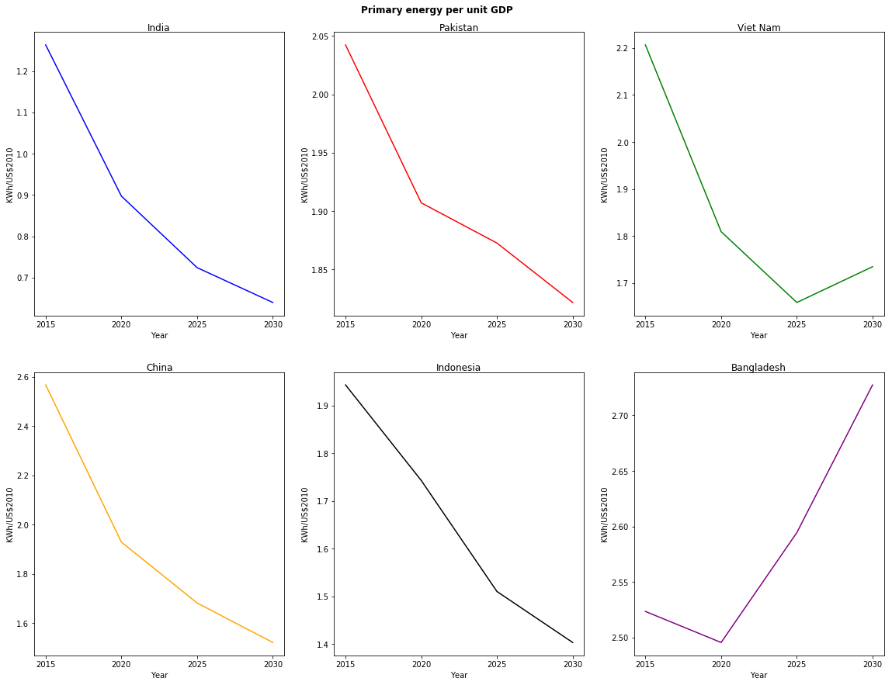
NDC & SDG-7 Performance Indicators @ baseline (Energy Efficiency)
Energy consumption per unit of GDP is decreasing for all countries
Energy consumption per unit of GDP is expected to grow in Bangladesh (Likely reason could be shifting from biomass to modern fuels)
Please Do Not Quote
Source: TA 9690 baseline results ( Results are indicative and subject to change )

Slide 27
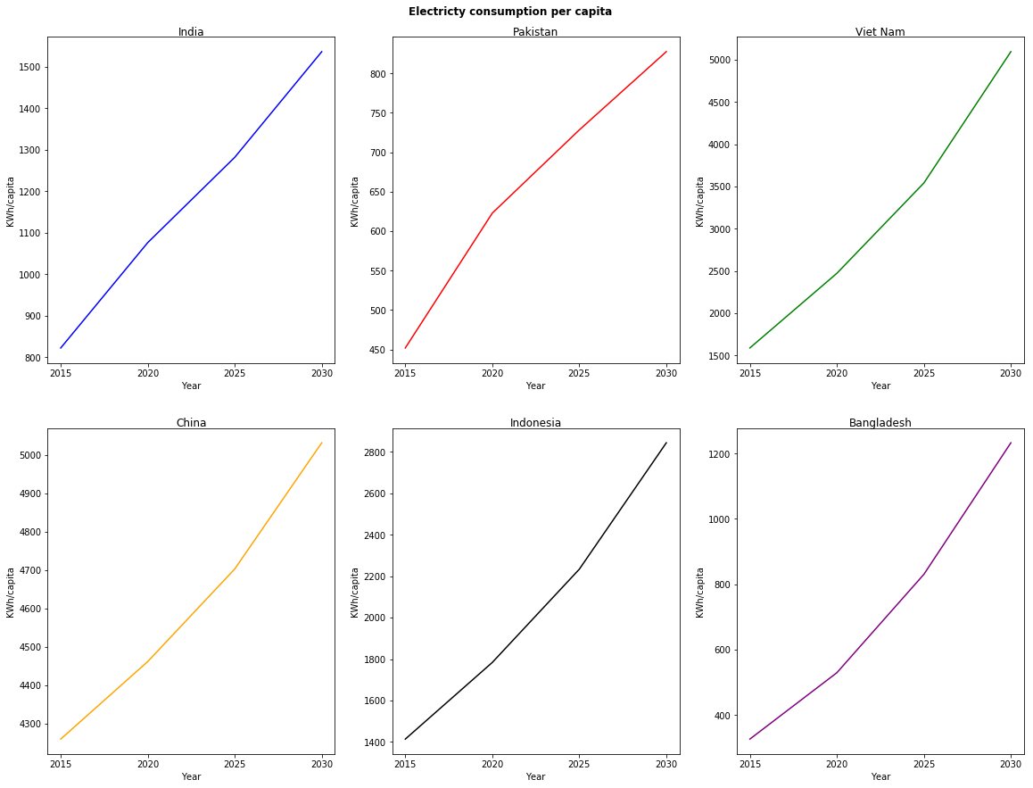
NDC & SDG-7 Performance Indicators @ baseline (Access to electricity)
Per capita electricity consumption is increasing in all countries in the region ensuring improving access to modern energy
Please Do Not Quote
Source: TA 9690 baseline results ( Results are indicative and subject to change )

Slide 28
Emissions performance in the baseline projection
Emissions from energy use
Country | 2020 (MtCO₂e) | 2030 (MtCO₂e) | NDC Target by 2030 (MtCO₂e) | Remarks
Bangladesh | 70 | 216 | 200 | Easily Achievable Target revision margin is low
China | 12,500 | 13,400 | 15,000 | Easily Achievable Target revision margin is low
India | 3,140 | 4426 | 6,000 | Easily Achievable Target revision margin is low
Indonesia | 1,470 | 2,130 | 1,750 | Additional effort required to meet the existing target
Pakistan | 200 | 310 | 700 | Easily Achievable Target revision margin is high
Vietnam | 300 | 520 | 815 | Easily Achievable Target revision margin is high
Please Do Not Quote
Source: NDC Targets by 2030 referred from the respective country NDC submissions, available at https://www4.unfccc.int/sites/NDCStaging/Pages/All.aspx
Source: TA 9690 baseline results ( Results are indicative and subject to change )

Slide 29
Focusing on balanced approach of target achievement / Post pandemic readjustment
6

Slide 30
Balanced approach for NDC/SDG achievement
Region has set the ball rolling towards low carbon development. Some of the indicators are performing well towards target achievement like access to electricity and clean cooking.
Renewable energy share is not increasing in the region as it was expected. It is evident that is additional support is required.
NDC targets in the region are often achievable and thus can be revised with higher emissions reduction.
Post COVID-19 pandemic, regional economy will be very weak and thus the initial target achievement might be affected. Thus, cost base priority of mitigation actions will be important.
Demand side mitigation measure are often less expensive but less important in NDC activity list. Under current situation, countries should reconsider those activities like industrial EE and decarbonization, building energy efficiency, non-motorized transportation, use of inland water ways as suitable options.
Demand side target based NDC could be low cost mitigation options for the countries.
Renewable energy requires continuous policy support for its advancement. However, storage technologies could be the game changer that can fast-track the implementation of RE.

Slide 31
Thank you
Anindya Bhattacharya PhD
anindya.b@thecelestialearth.org
Manoj Bansal
manoj.bansal@pwc.com
© 2020 PwC. All rights reserved. Not for further distribution without the permission of PwC. “PwC” refers to the network of member firms of PricewaterhouseCoopers International Limited (PwCIL), or, as the context requires, individual member firms of the PwC network. Each member firm is a separate legal entity and does not act as agent of PwCIL or any other member firm. PwCIL does not provide any services to clients. PwCIL is not responsible or liable for the acts or omissions of any of its member firms nor can it control the exercise of their professional judgment or bind them in any way. No member firm is responsible or liable for the acts or omissions of any other member firm nor can it control the exercise of another member firm’s professional judgment or bind another member firm or PwCIL in any way.

Slide 32
Moderator’s Questions for Panelists:
Key Technology Portfolio Roadmaps - approaches and findings
What are the new / emerging technologies that would play a pivotal in transforming the energy sector? E.g. hydrogen, energy storage etc. How should countries adopt a strategy to scale up these technologies and what kind of support should be sought from the developed countries? What kind of business models need to be explored?
While countries are targeting increased penetration of renewables into the energy mix, what could be the potential challenges / risks that could hit the transmission and distribution side? What are the best practices / approaches countries need to adopt to ensure grid stability?
Can technology roadmaps specific to the demand side (buildings, transport) provide a more effective way for transition to a low carbon pathway?
How should countries develop an energy sector low carbon roadmap that synergizes with sector specific roadmaps?
How digital technologies could help the energy sector overcome challenges and barriers for transition to a low carbon system?

